Slide 1
Moving on to cell division proper……. Why is cell division important?
Unicellular organisms
Cell division of one cell reproduces another organism (asexual reproduction)
Multicellular organisms
Cell division of germ cells in testes and ovaries produces gametes (sexual reproduction)
Cell division enables organisms to grow and develop from single zygote
Cell division enables organisms to repair and replace damaged and worn-out body cells

Slide 2
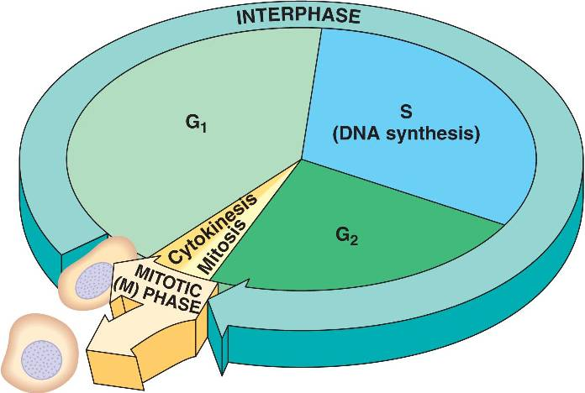
What is cell division?
What is the cell cycle?
Sequence of events from the time a cell is formed until its division into two daughter cells
The cell cycle consists of three stages:
Interphase (resting stage)
Mitosis (nuclear division)
Cytokinesis (division of the cytoplasm)
Notes:
Discussion Points:
Cell division is made up of nuclear division (mitosis) + cytoplasm division (cytokinesis)

Slide 3
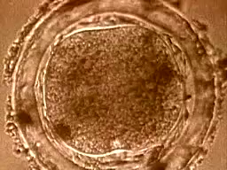
What is cell division?
Notes:
Video to highlight nuclear division and cytoplasmic division (cytokinesis)

Slide 4
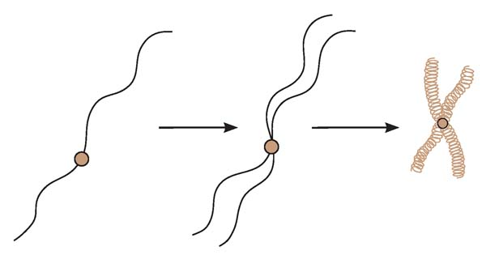
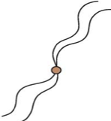
Chromatin Vs Chromatids Vs Chromosomes ????????
chromatin thread
sister chromatids
chromosome
centromere
DNA replication
chromatin threads coil and shorten
The chromatin thread replicates to produce two identical chromatin threads → sister chromatids
These chromatin threads coil and shorten → condense → to become chromosomes.
Notes:
Discussion Points:
Each chromatin is a double stranded helix DNA → not condensed and look threadlike
Chromatin replicate and form 2 strands held at centromere → not condensed and still look threadlike, now in pairs
When 2 strands of chromatins are together → sister chromatins → not condensed then
The sister chromatids (2) condense → chromosome (X structure)
1 chromosome is still made up of 2 sister chromatids (now it is condensed)
So sister chromatids can be in decondensed or condensed form depending on which state you look at them → chromatin state or chromosome state

Slide 5
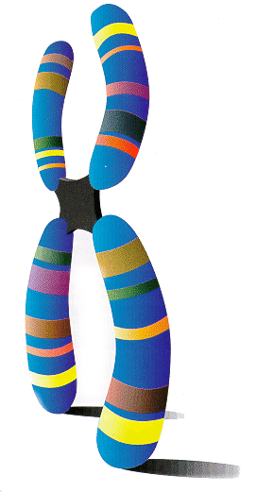
Chromatids
At the end of replication, there are 2 identical DNA molecules, held together at a point along their length called the centromere.
Chromatids correspond to the 2 identical parts of the replicated chromosome.
Since the 2 chromatids are identical, they are termed as sister chromatids.
As soon as sister chromatids are separated during cell division, they are referred to as individual chromosomes again.

Slide 6
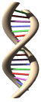
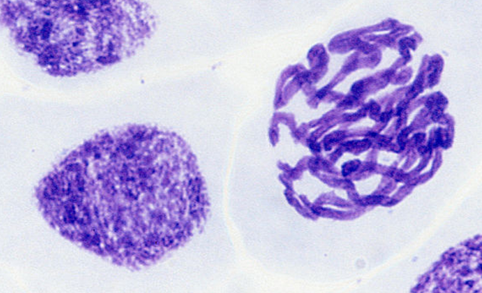
Chromosomes
Most important structures in the cell during division
Responsible for the transmission of the hereditary information from one generation to the next.
Contain DNA, the molecule of inheritance
Chromosome:
Genetic material appears as distinct, thick, compact, condensed structures
Chromatin:
Genetic material appears as diffused mass

Slide 7
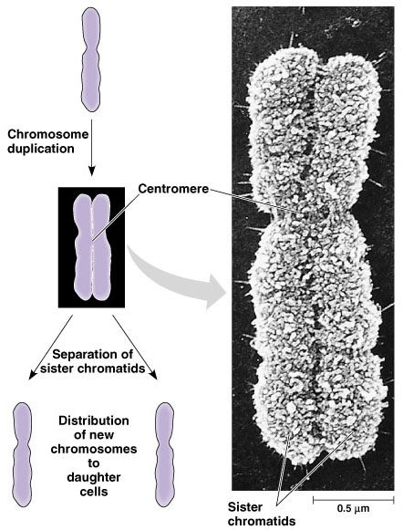
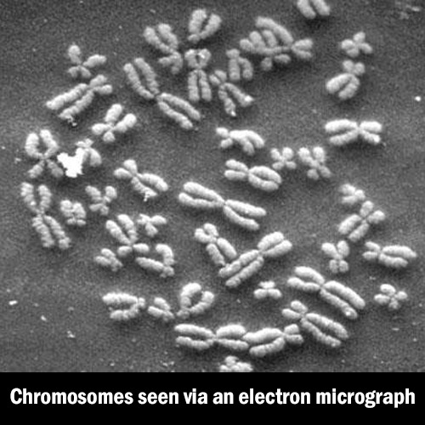
What are chromosomes?
Notes:
Discussion Points:
Chromosome can be double stranded or single stranded
Single stranded and condensed(during anaphase) → individual chromosome/daughter chromosome.

Slide 8
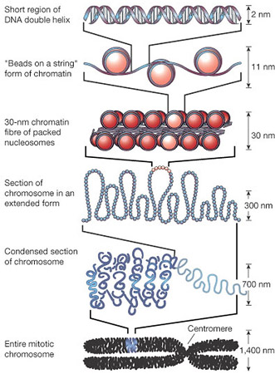
Behaviour of Chromosomes
During interphase, long thin threads that are loosely coiled are seen spread throughout the nucleus.
These long fibres are known as chromatin

Slide 9
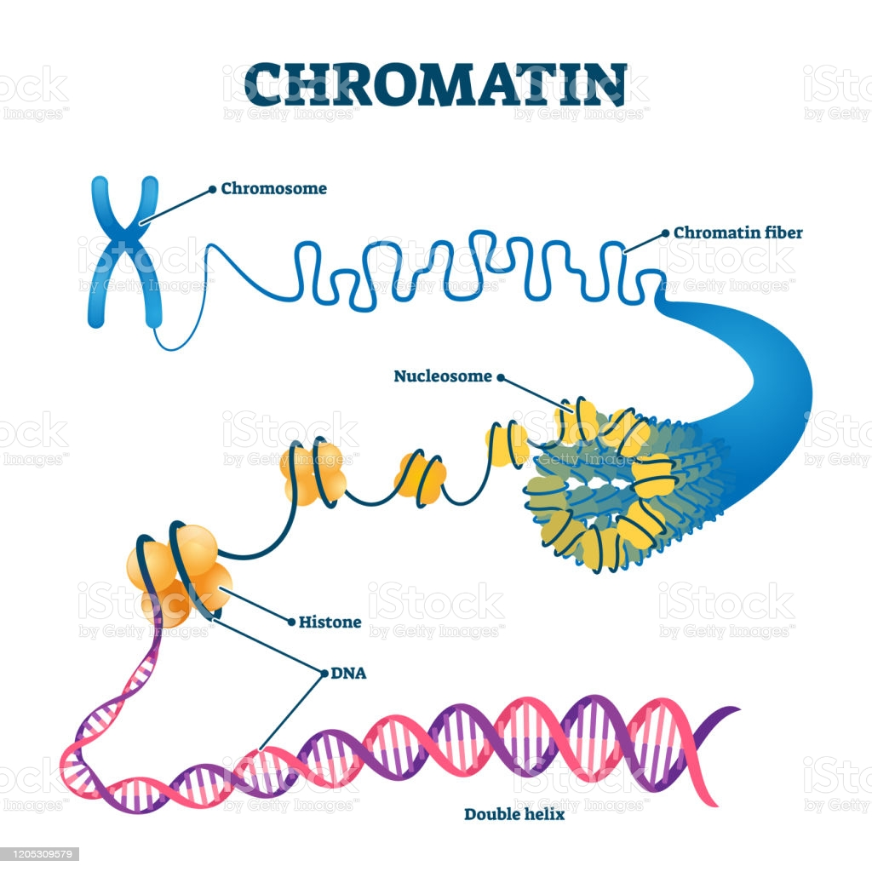
Behaviour of Chromosomes
Just before nuclear division, chromatin fibres condense (coil up) into much more compact structures, appearing shorter, thicker.
After replication they appear as double structures.
These compact structures are now called chromosomes.

Slide 10
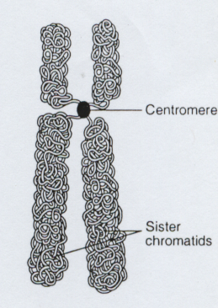
Centromere and Kinetochore
Centralised region joining two sister chromatids
It can occur anywhere along the length of the chromosomes.
Direct the formation of an elaborate protein complex, the kinetochore (2 complexes the sister chromatid pair)

Slide 11
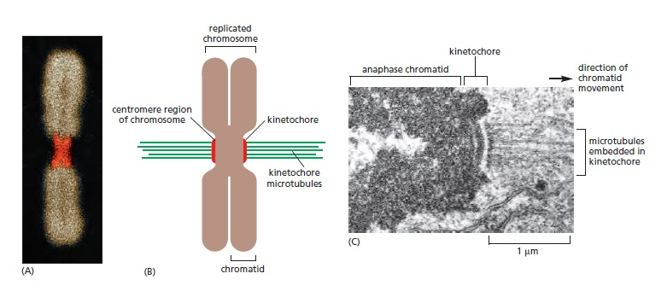
Centromere and Kinetochore
Kinetochore provides the major attachment point for spindle microtubules during nuclear division

Slide 12
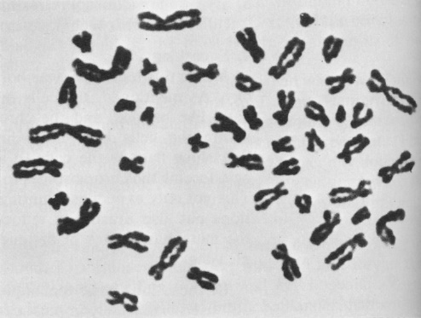
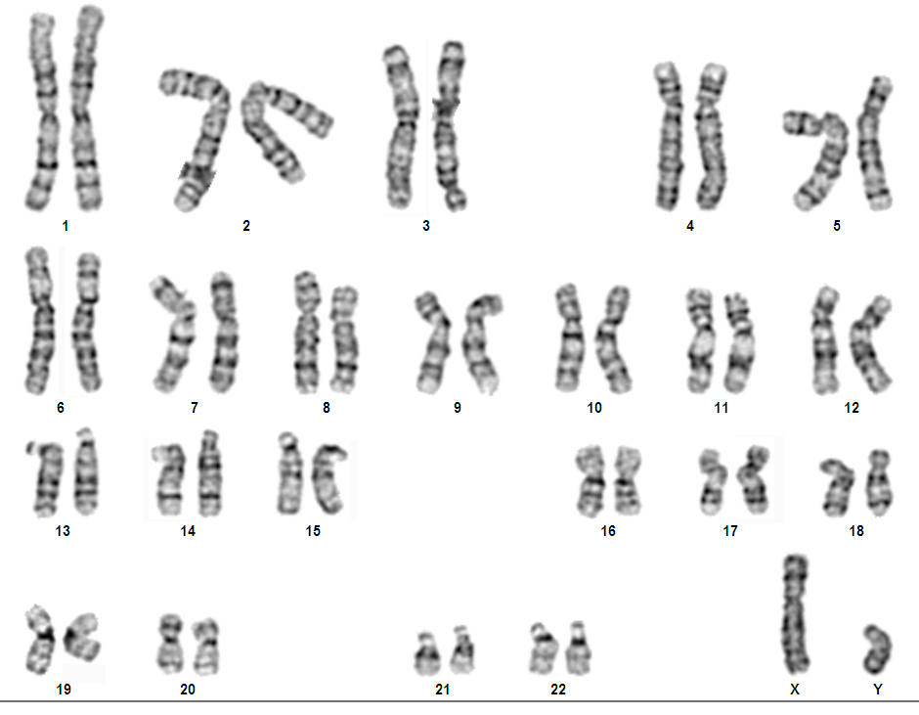
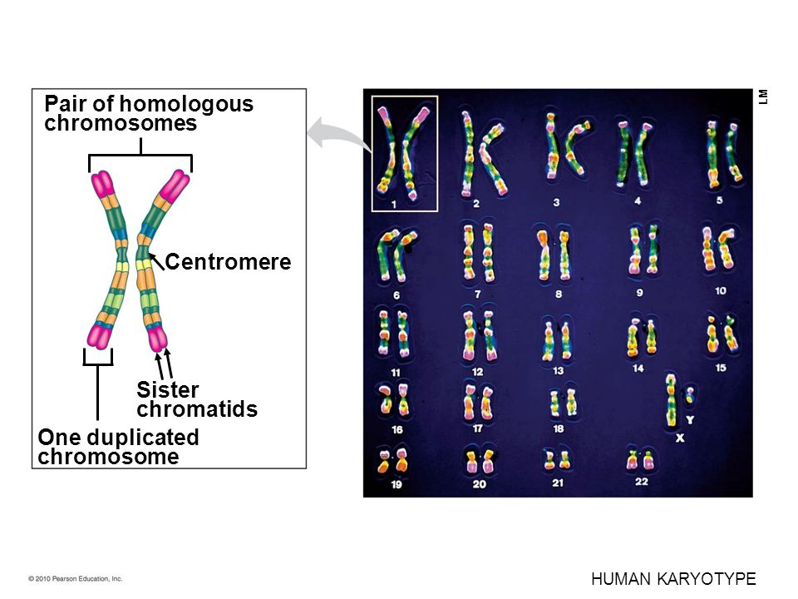

The human karyotype
Notes:
Discussion Points:
All humans → 23 pairs of homologous chromosomes. Meaning of the term homologous will be covered later
22 autosomal pairs and 1 pair of sex chromosomes (pair 23 which comprise X and Y chromosome)
Each pair of homologous chromosome → one chromosome from mother and one chromosome from father

Slide 13
Chromatids vs Chromosomes
 | Chromatids | Chromosomes
1 | Replicated form of a chromatin joined at centromere (decondensed) Replicated form of a chromosome joind at the centromere (condensed) | Collectively refers to the pair of sister chromatids in a replicated chromosome, or unreplicated DNA molecule, or separated chromatids after anaphase; (give at least two points)
2 | Each exists in duplicate / as 2 genetically identical copies (or sister chromatids) held by a centromere | Each exists singly / as a single entity
3 | Each is separated from the other copy (sister chromatid partner) during mitotic anaphase | At mitotic anaphase, chromosomes are the separated chromatids → individual chromosome

Slide 14
Chromatids vs Chromosomes
 | Chromatids | Chromosomes
4 | Sister chromatids exist as a pair in mitosis | (Homologous) chromosomes not paired in mitosis
5 | Sister chromatids are genetically identical | No two chromosomes are genetically identical; (unless they are duplicates e.g. separated sister chromatids after anaphase)
6 | Sister chromatids contain identical gene loci | Only homologous chromosomes contain identical gene loci
7 | 1 chromatid is 1 single DNA molecule | 1 chromosome can consist of either 1 or 2 (for a replicated chromosome) DNA molecule(s)

Slide 15
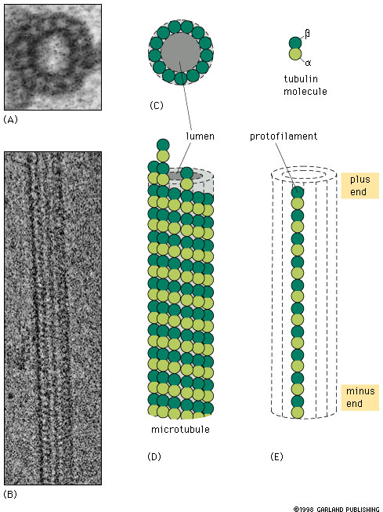
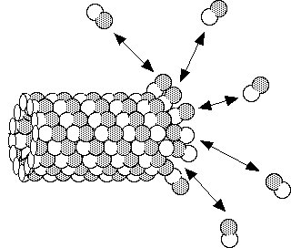
What are microtubules?
Tubular polymers of tubulin (globular protein)
- form rigid hollow rods
Form cytoskeleton in cytoplasm
Notes:
Discussion Points:
Tubulin can polymerise → add on to form the hollow rods which are microtubule → elongation of microtuble
The tubulin can also depolymerise → break apart from the hollow tube → shortening of microtubule
Microtublues are essential in nuclear division in cells → discuss later
Cytoskeleton →helps cells maintain their shape and internal organization, and it also provides mechanical support that enables cells to carry out essential functions like division and movement

Slide 16
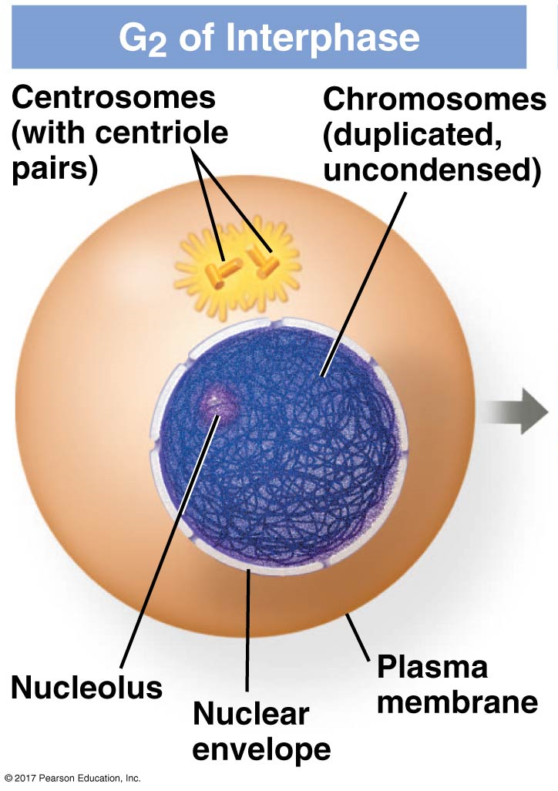
What are microtubules?
Microtubules extend outwards from the microtubule organizing center (MTOC) = centrosome
In animal cells, centrosome has a pair of centrioles
Notes:
Discussion Points:
Microtubles extend out from MTOC→ polymerization of tubulin
Figure shows 2 centrosomes = 2 pairs of centrioles as at G2 the centrosome has duplicated

Slide 17
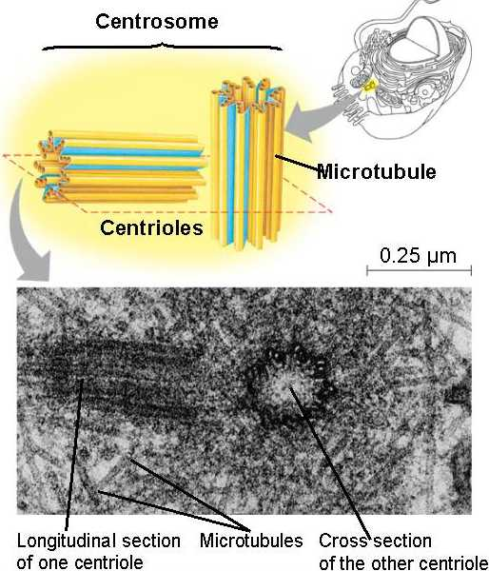
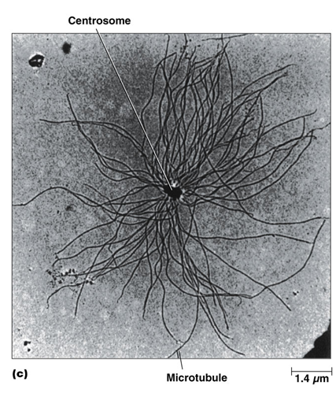
What are microtubules?
Centrioles are cylindrical structures consisting of 9 triplets of microtubules
The 2 centrioles lie at right angles

Slide 18
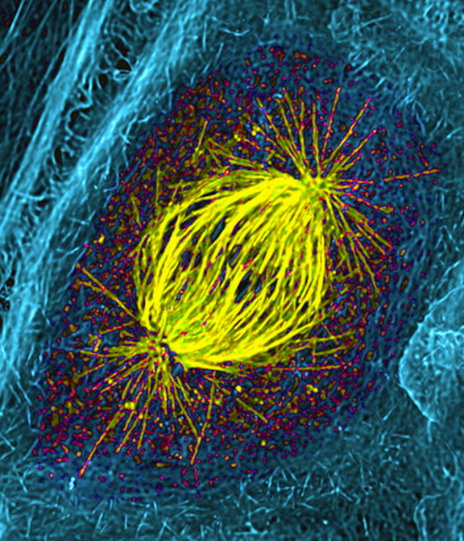
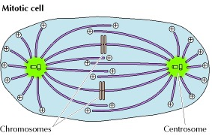
What are microtubules?
During cell division, duplicated centrosomes assemble and organize microtubules to form mitotic spindle

Slide 19
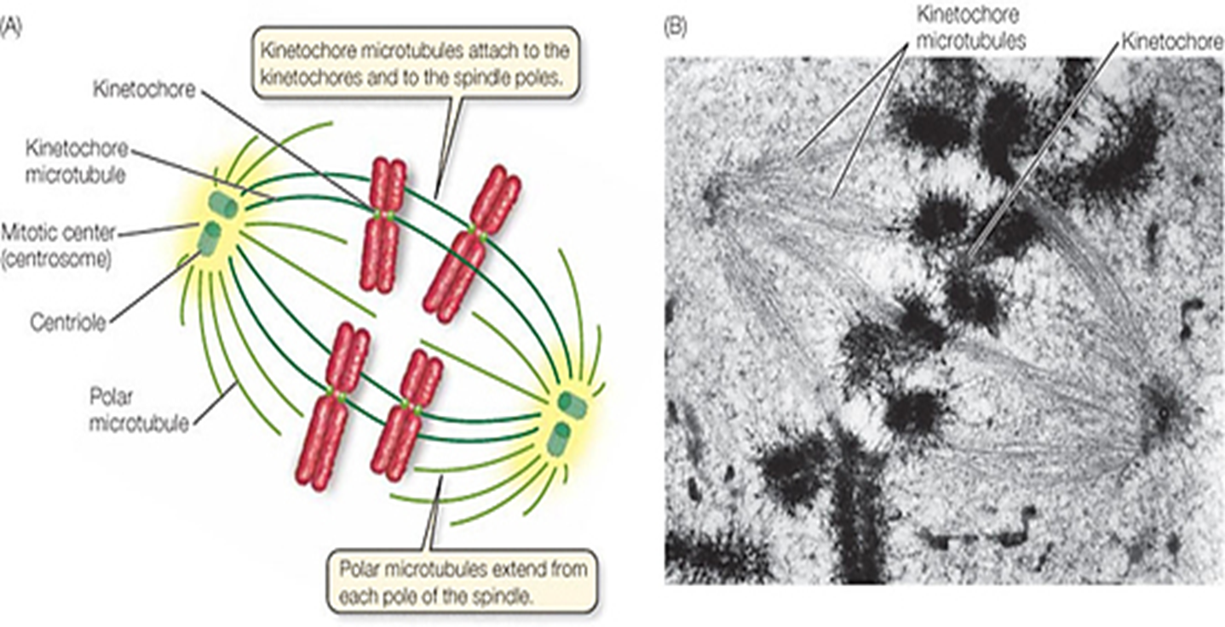
What are microtubules?
What makes up the mitotic spindle?
Notes:
Discussion Points:
Mitotic spindle made up of 2 main types of microtubules → Kinetochore microtubules and polar microtublues/non-kinetochore microtubules
Kinetochore microtubules → attach to kinetochore of chromosome → help in the alignment of the chromosomes in mitosis (seen later)
Polar/non-kinetochore microtuble → not attached and elongate → crucial in mitosis (seen later)
Note: Do not need to focus on aster as it are not impt in this module (seen in other slide)

Slide 21
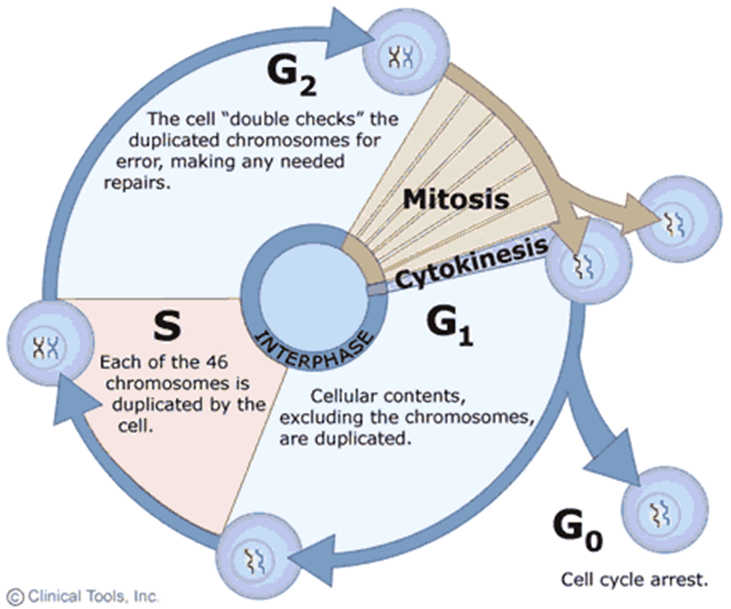
What happens during interphase of cell cycle?
Interphase is also known as the ‘resting’ or non-dividing stage.
During this stage, the cells
absorb nutrients
build up protoplasm
synthesise new organelles
replicate DNA

Slide 22
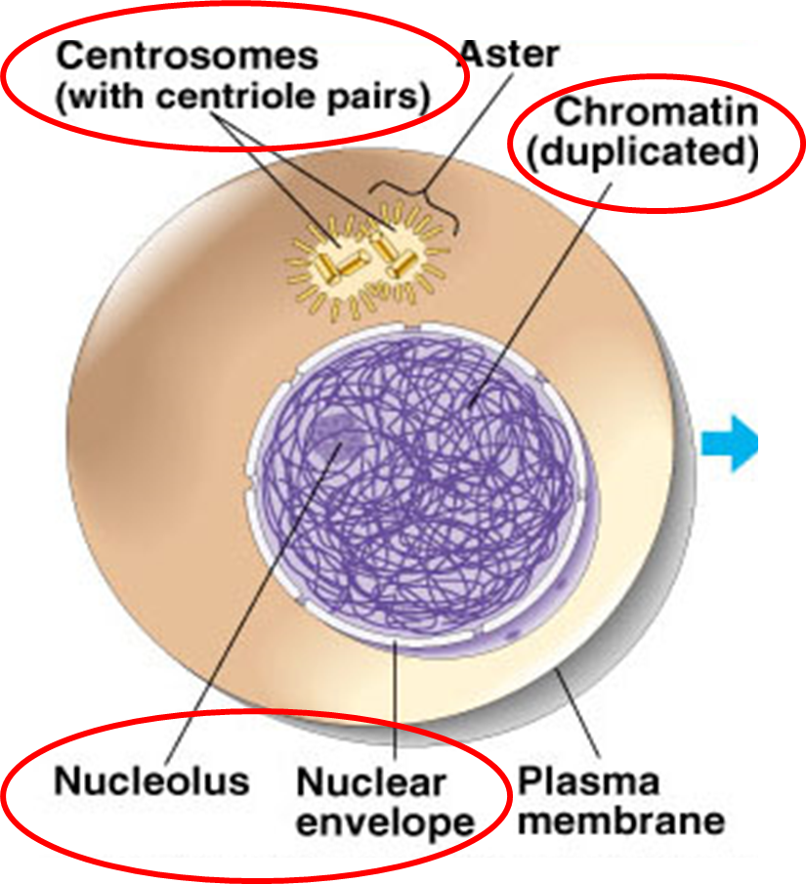
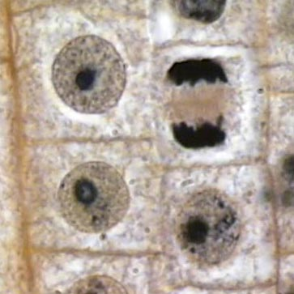
What happens during interphase of cell cycle?
Notes:
The figure on left shows cell at G2 of interphase, just before mitosis.
Highlight:
Centrosome has duplicated → 2 seen in figure
Chromatin duplicated and are double stranded (DNA content = 2x → 92 DNA strands)
Nuclear envelope still present and seen
Nucleolus still present and seen
Ask students which cells are in interphase in the photomicrograph?

Slide 23
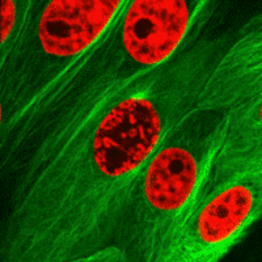
What happens during nuclear division (mitosis)?
Notes:
Moving on to mitosis with a video. Do not go through details as students will do Learning Task first before they get details.

Slide 24
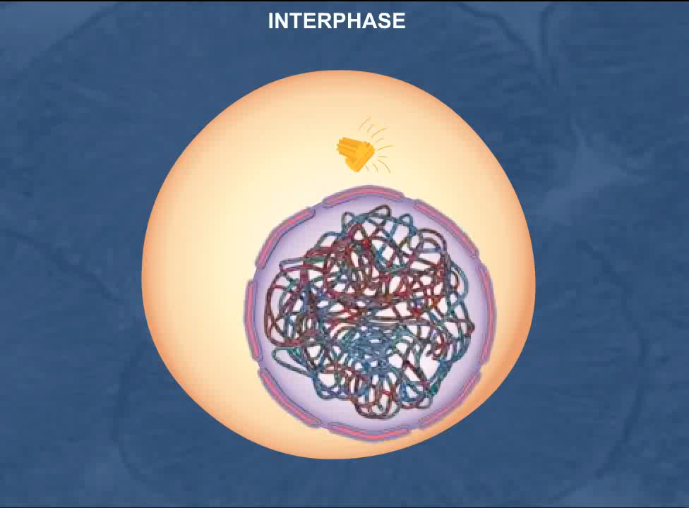
What happens during nuclear division (mitosis)?
https://highered.mheducation.com/sites/9834092339/student_view0/chapter10/mitosis.html
Notes:
Moving on to mitosis with a video. Do not go through details as students will do Learning Task first before they get details.

Slide 25
What happens during nuclear division (mitosis)?
Four key stages:
Prophase
Metaphase
Anaphase
Telophase

Slide 26
Learning Task 6A - Mitosis
Match the diagrams of animal cells and photomicrographs of plant cells into the correct stages of mitosis
Match the descriptions of cellular events to the correct stages of mitosis
Complete 2 other questions

